Slide 1
Battery
Vehicle computer
Power distribution unit
Network switch
Actuator controller
Sensor DAC unit
Actuator
Pressure sensor
Pressure sensor
Pressure sensor

Slide 2
Workflow Overview
User editable per product
Generated file
When you “render” a product (run harnice –r from the command line or GUI button press), a long process is executed.
During the process, existing information is queried, processed, and every output is regenerated.
device
Device Feature Tree
Device Signals List
Device Kicad Symbol
System Definition (kicad_sch)
System Feature Tree
System Instances List
system
Harness feature tree
Harness Instances List
Harness Build Drawing PDF set
harness

Slide 3
Defined Manually
Defined in Device Feature Tree
Defined in System Feature Tree
Defined in Harness Feature Tree
Device Signals List
Device, channel definitions
System build rules
KiCad symbol
Channel map, disconnect map, circuits list
System Instances List
System harness manifest, post harness instances list
System simulation processor
KiCad block diagram
Netlist
Harness build rules
Harness instances list
Harness drawings

Slide 4
Signals List Feature Tree
You can use a script to easily write long Signals Lists. Rely on basic Python to avoid typing manually.
harnice -r device
Or
harnice -r disconnect
Signals List Exists
no
yes
Feature Tree Exists
Feature Tree Exists
yes
yes
no
no
Make new feature_tree.py from default
Run feature_tree.py
Validate and exit

Slide 5
PDF Generator
This is the notional flow of SVG content when you run the PDF generator macro.
Titleblocks in library repo
The graph on this page shows the relevant part of the file hierarchy of a harness project.
Harness rev folder
directory
instance_data
json
svg
Literally any file that ends in –master.svg
imported_instances
PDF
1. Import titleblock content into project
Titleblock
Macro
Project titleblock folders
{Macro that called it}-
{page number}-
{page name}
4. Go find all generated content
{Macro ID}
Library_used_do_not_edit
Page_svgs
Page_setup.json
Project titleblock files
direct_from_project_titleblock
Master contents svg
{macro id}-{page name}-attributes.json
5. Merge into user editable page svg
Output PDF
6. Combine into output PDF
{macro id}-{page name}-drawing.svg
{page_counter}-{page name}-user editable.svg
1.5 User can edit titleblocks directly here
2. Copy into macro directory
Macro-{macro ID}-{page name}
Macro titleblock files
5.5 User can configure page content and layout here by cloning master contents groups and placing the clones on the page
{macro id}-{page name}-attributes.json
5. Merge into user editable page svg
3. Text replacements automatically performed (adds page number, pn/rev, etc)
{macro id}-{page name}-drawing.svg
{macro id}-{page name}-drawing_with_text_replacements.svg

Slide 6
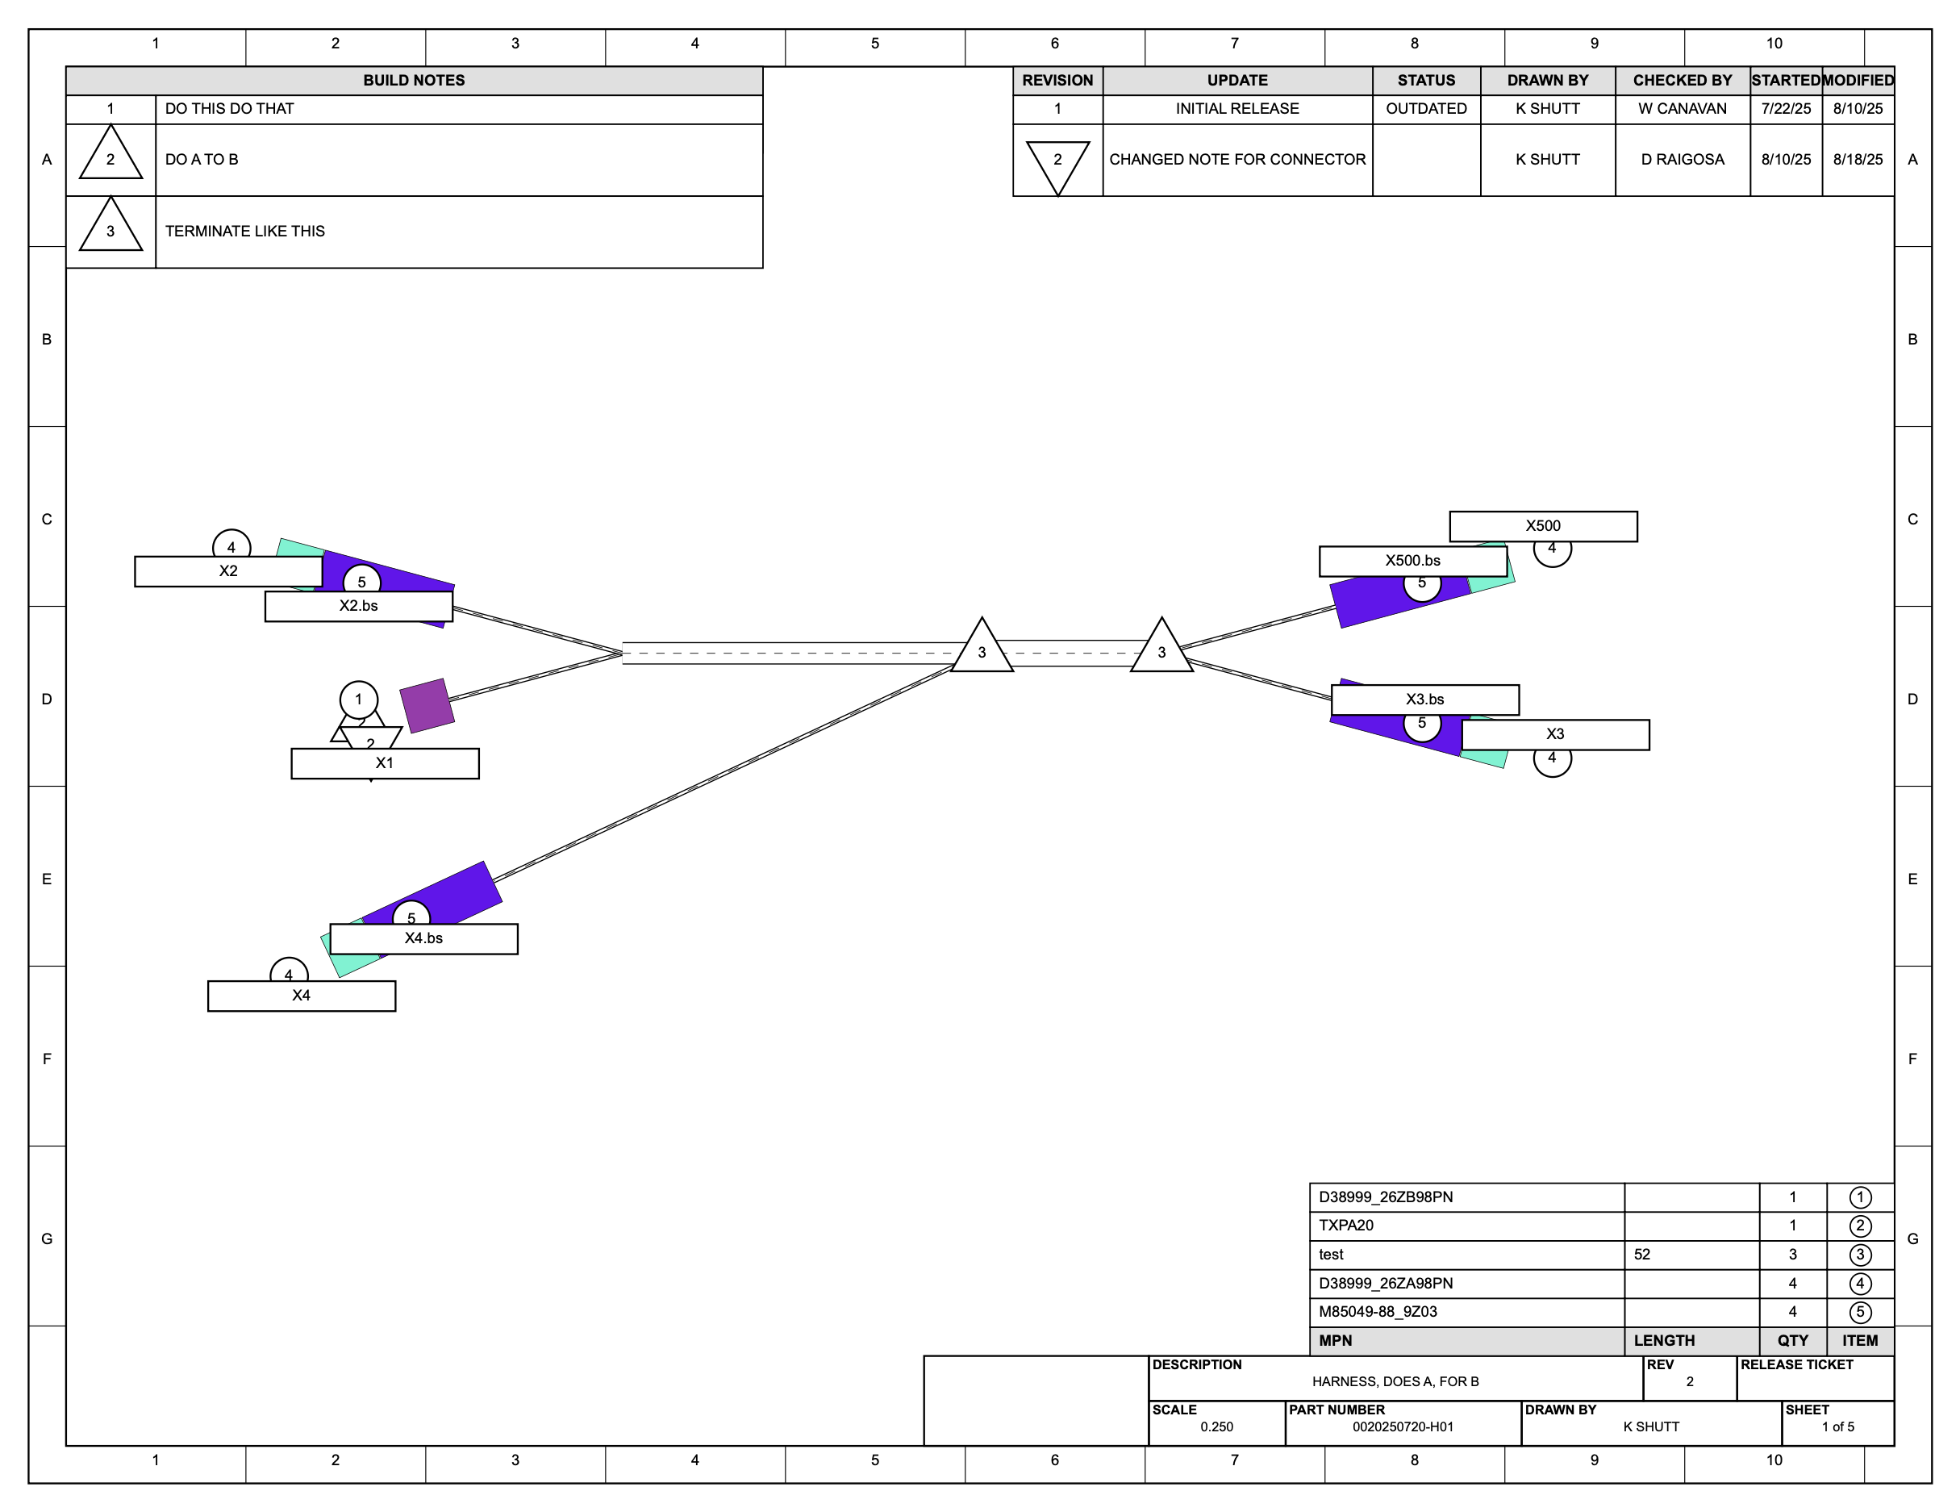

Slide 7
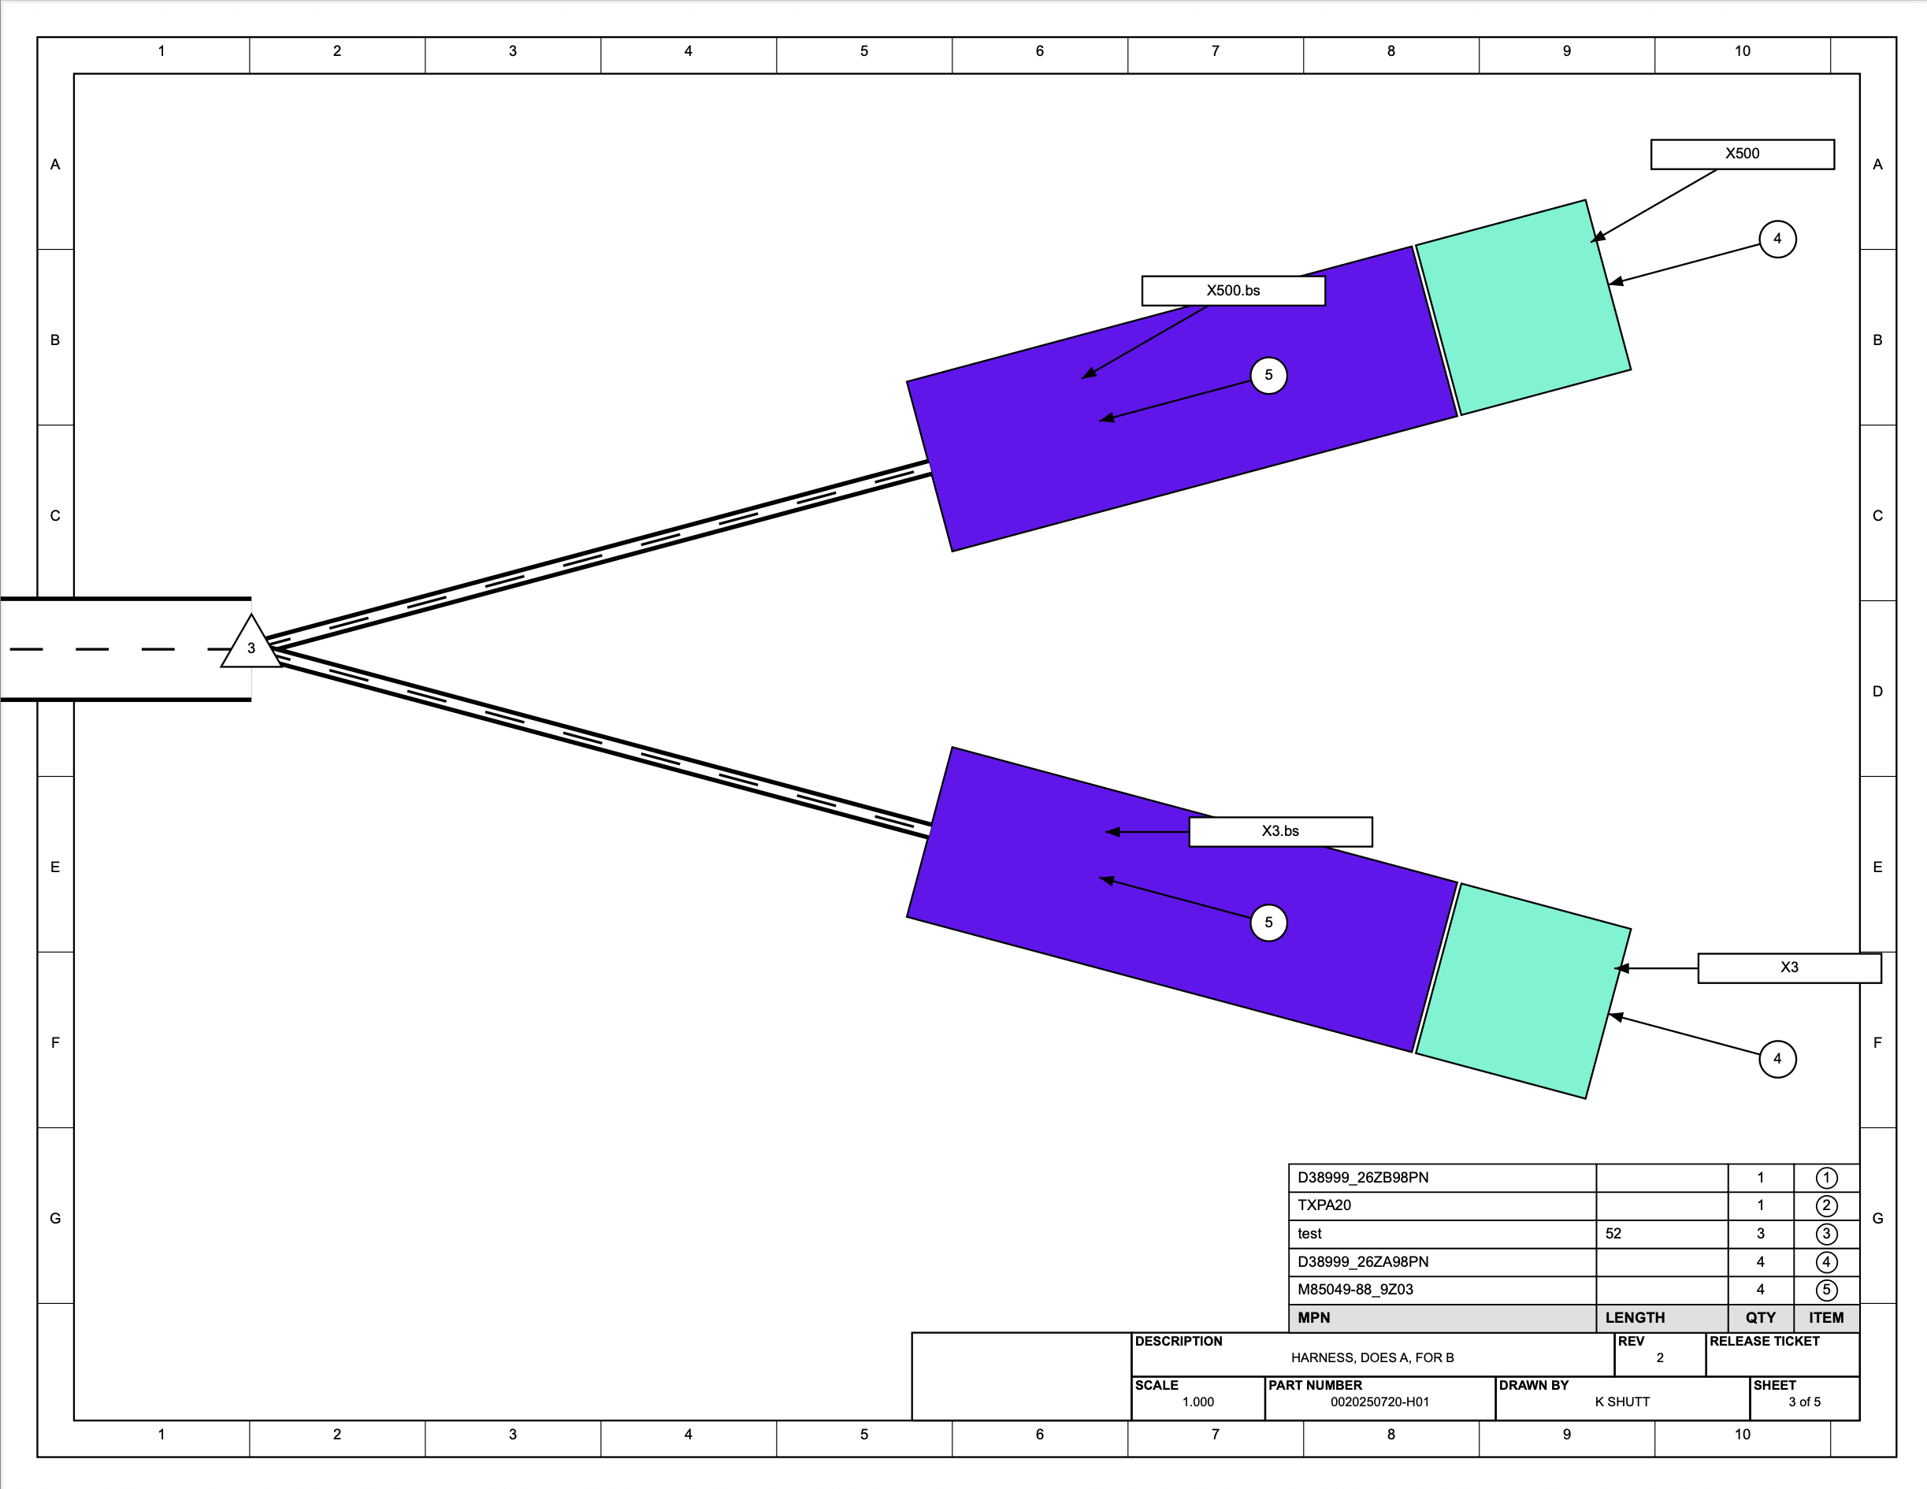

Slide 8
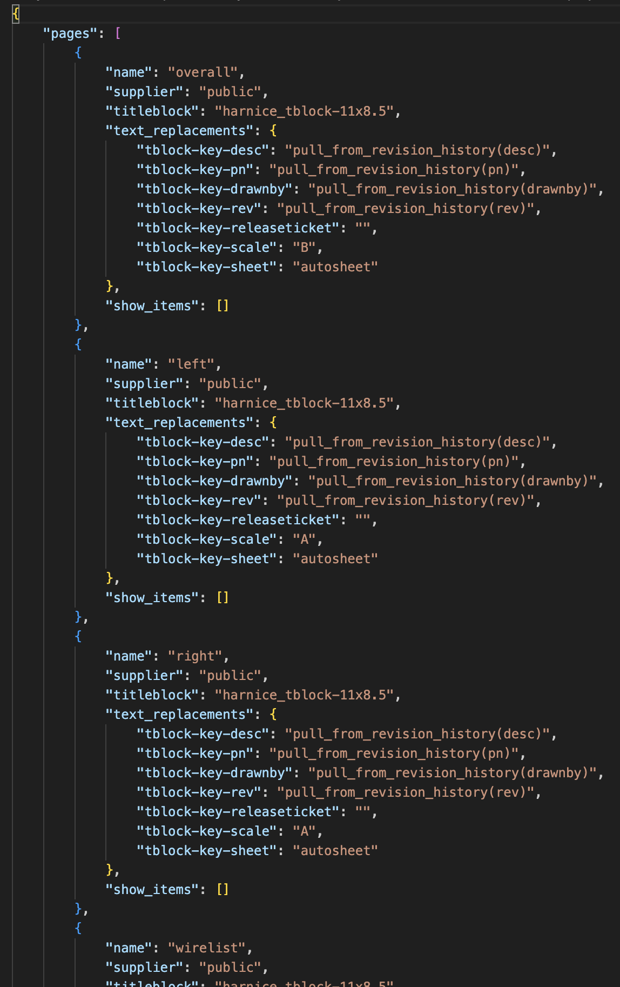
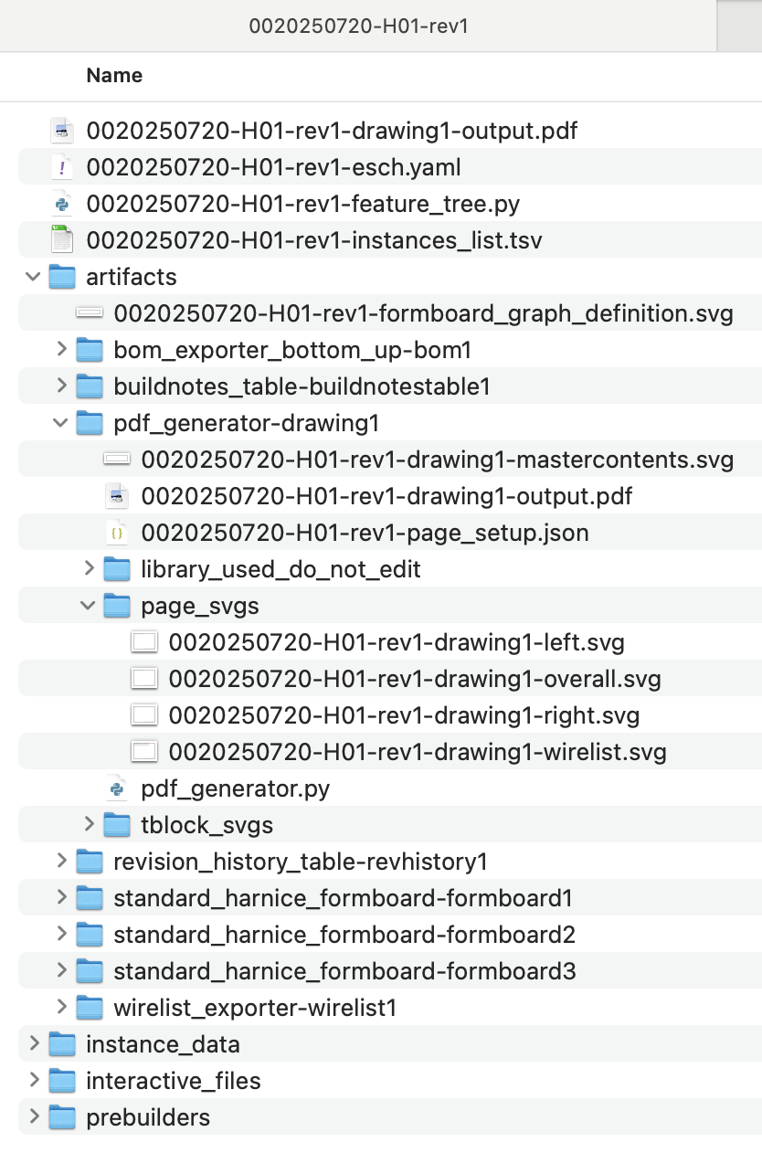
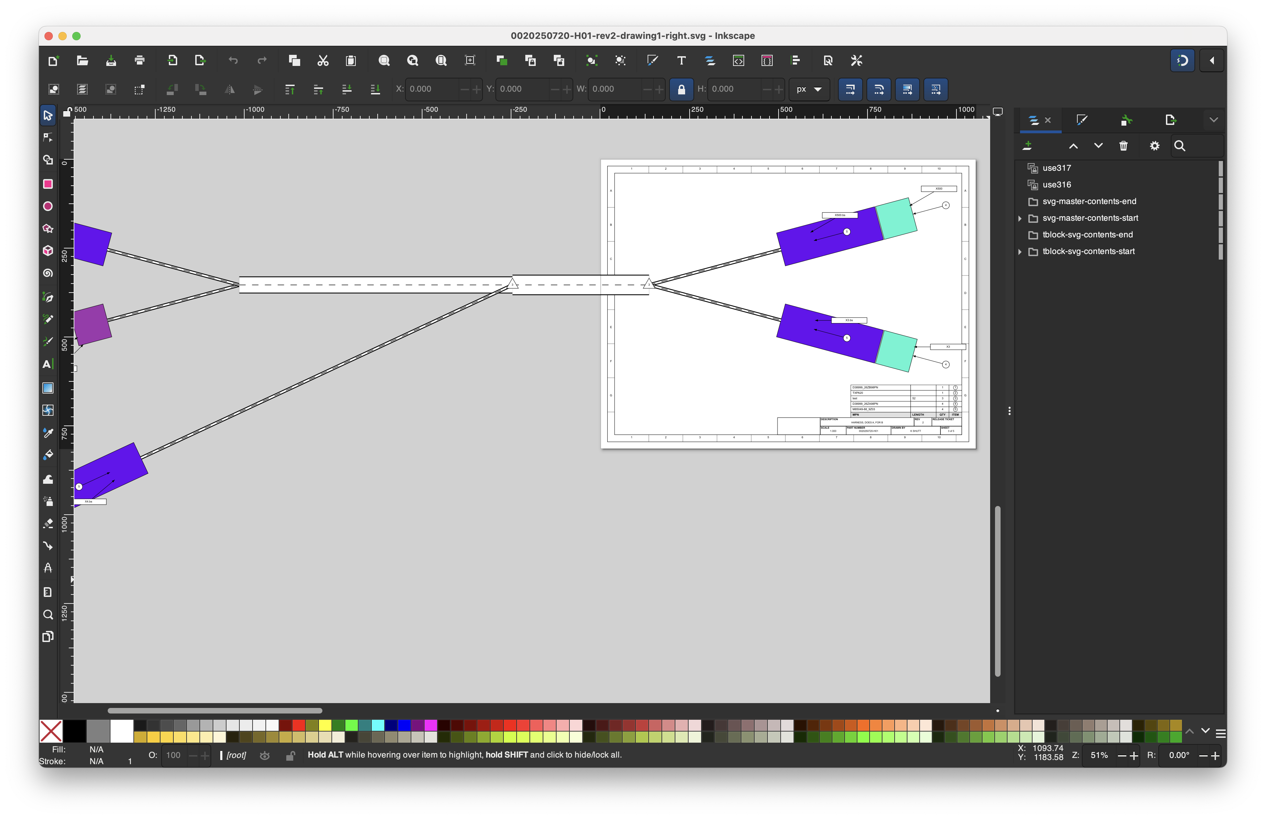

Slide 9
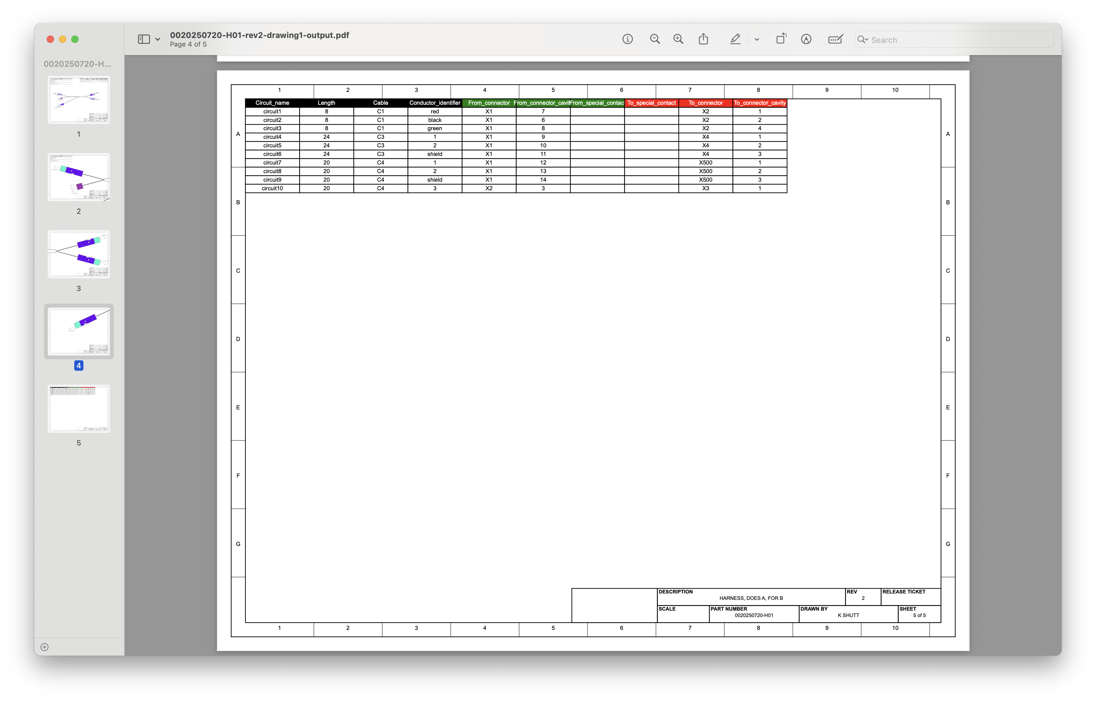
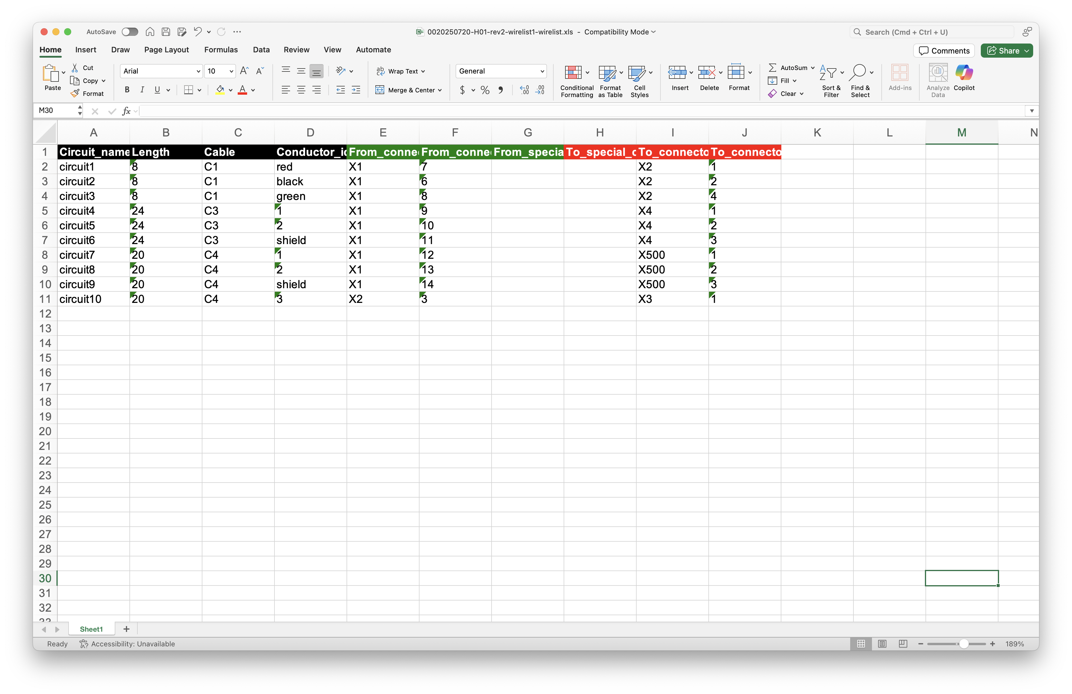
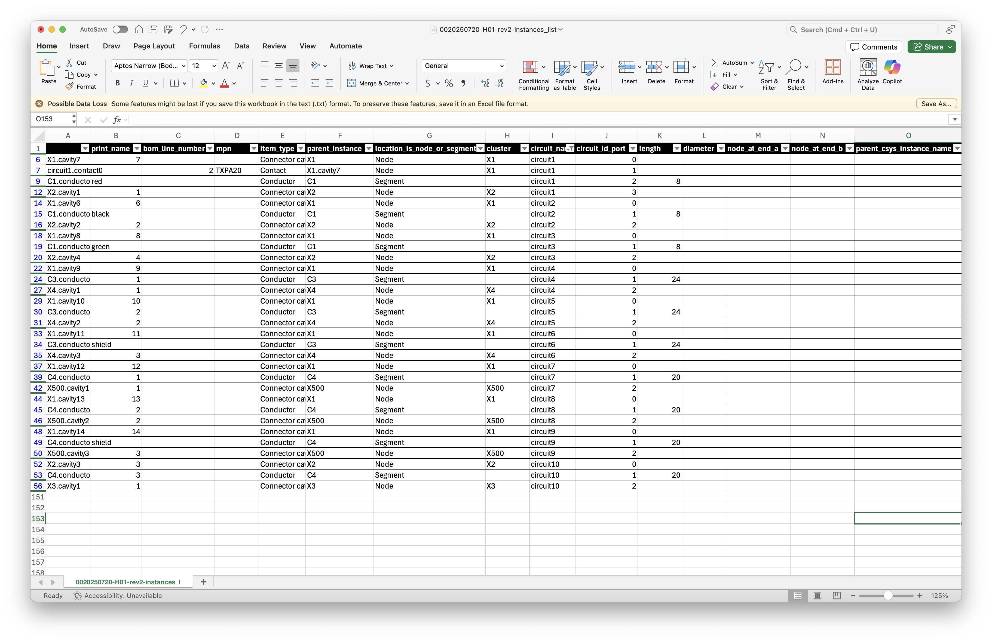

Slide 10
